Slide 1
SMART RAINWATER HARVESTING USING AI WITH SKILLED INSTALLERS
PPT DONE BY,
Team ID : S4F_CP_Team_39633
PAMITHA M
[A9CF435B4FEE0B09B4E42F94DE46ACF0]
RAMPRIYA A
[FE321E5EF351BB8A8104E5F14E4D4B0F]
PRIYA N
[B20632EBAE0286D8CA74FE57A7EDA57D]

Slide 2

SMART RAINWATER HARVESTING
USING AI WITH SKILLED INSTALLERS

Slide 3
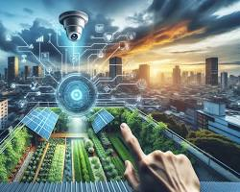
INTRODUCTION
This presentation explores the integration of AI-driven smart rainwater harvesting systems, which leverage advanced technology to optimize water collection and management. By incorporating data analytics and machine learning, these systems can dynamically adjust to environmental conditions. The role of skilled installers is crucial, as their expertise ensures proper system setup and maintenance, leading to enhanced efficiency and sustainability in addressing global water management challenges.

Slide 4
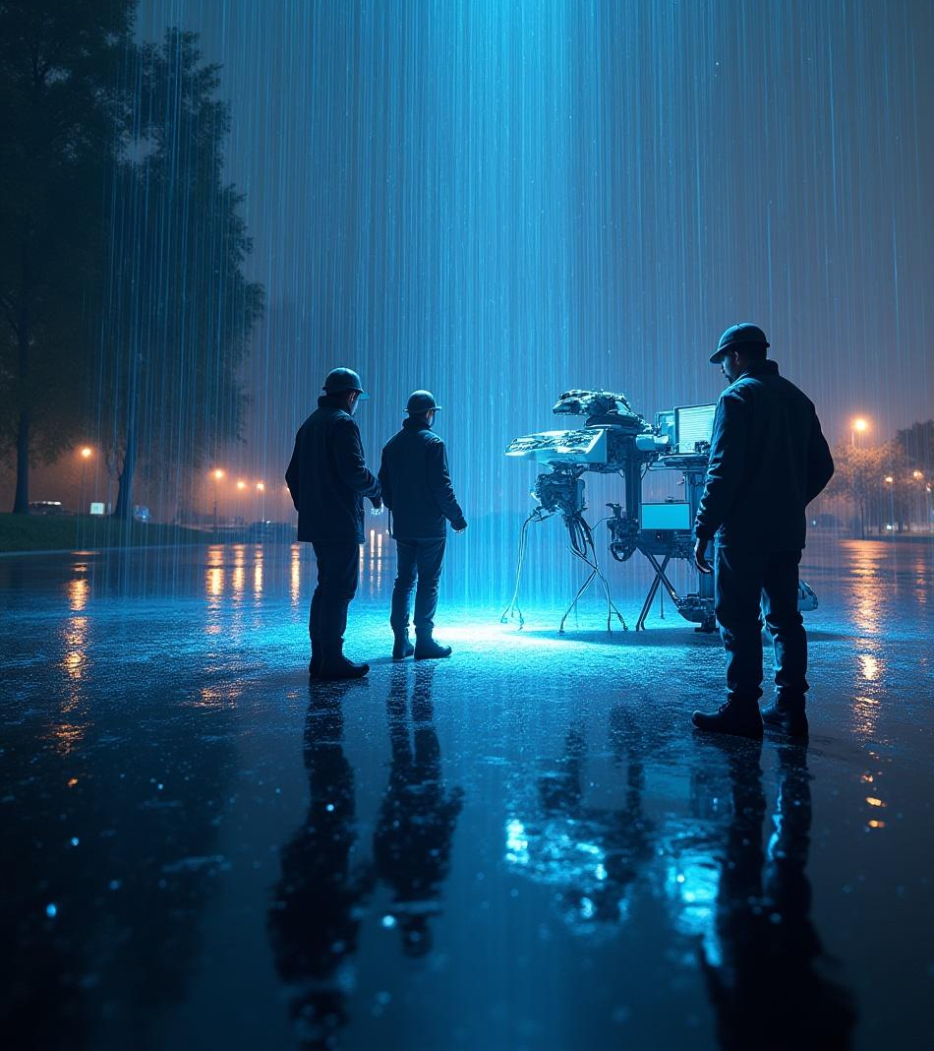
Smart Rainwater Harvesting Using AI with Skilled Installers is an innovative approach to managing water resources efficiently. This presentation highlights how artificial intelligence can optimize harvesting systems, enhancing their effectiveness in diverse climates. The collaboration with skilled installers ensures that these advanced systems are correctly implemented and maintained, ultimately leading to improved sustainability and resource conservation in water management practices.

Slide 5

IMPORTANCE OF SMART RAINWATER HARVESTING
Smart rainwater harvesting is essential for maximizing water efficiency, especially in regions facing water scarcity. By reducing waste, these systems not only conserve valuable resources but also contribute to environmental sustainability. The integration of artificial intelligence further enhances these systems by analyzing data to optimize collection, storage, and distribution, thereby maximizing output and ensuring that communities can rely on a consistent water supply. This innovative approach is crucial for future water management strategies.

Slide 6
ROLE OF SKILLED INSTALLERS AND AI
The role of skilled installers is critical in the successful implementation of smart rainwater harvesting systems. They not only ensure proper setup but also conduct regular maintenance, identifying issues early to prevent system failures. Meanwhile, artificial intelligence plays a pivotal part by analyzing real-time data, optimizing performance based on weather conditions, and adjusting the system accordingly. This synergy enhances overall water collection efficiency and promotes sustainable resource management.

Slide 7

CHALLENGES IN TRADITIONAL RAINWATER HARVESTING
Traditional rainwater harvesting systems often encounter significant challenges, including inefficiencies in water collection and storage processes. Manual operation can lead to maintenance issues, as these systems require regular checks and repairs, which may be overlooked. Additionally, their inability to adapt to changing weather patterns makes them less reliable. For instance, without real-time data, collectors may either overflow during heavy rains or underperform in dry spells, resulting in inconsistent water supply and resource wastage.

Slide 8
GOALS FOR SMART INTEGRATION
The primary goals for smart integration in rainwater harvesting systems focus on enhancing overall efficiency and reliability. By leveraging AI technology, these systems can predict water availability based on weather forecasts, ensuring optimal collection and utilization. Additionally, integrating advanced sensors allows for automated system adjustments that respond to real-time environmental changes, improving performance. Skilled labor plays a vital role, ensuring that installations are executed correctly and that systems are fine-tuned for maximum effectiveness. This combination significantly enhances water management practices.

Slide 9
KEY OBJECTIVES
The key objectives of the project focus on the development of an AI-powered system that significantly enhances the efficiency of rainwater harvesting. By utilizing advanced analytics, the system can optimize collection, storage, and distribution processes. Another objective is to enhance system automation, enabling real-time adjustments based on environmental data. Furthermore, it is essential to leverage the expertise of skilled installers to ensure correct implementation and maintenance, maximizing the system’s performance and longevity for sustainable water management.

Slide 10

DATASET OVERVIEWS AND SOURCES
Data includes rainfall patterns, water usage, and system performance from multiple geographic regions and climate conditions.

Slide 11
DATA COLLECTION TECHNIQUES
Data collection techniques are critical for ensuring the effectiveness of smart rainwater harvesting systems. Data is gathered through sensors that monitor rainfall, humidity, and soil moisture levels, providing real-time feedback. Additionally, weather stations contribute valuable data on atmospheric conditions, enhancing predictive analytics. Manual reports from skilled installers also play a vital role, offering insights into system performance and maintenance needs. This combination of automated and manual data collection ensures comprehensive accuracy and supports optimized water management decisions.

Slide 12
METHODOLOGY FRAMEWORK
The methodology framework integrates AI analytics with the expertise of skilled installers to enhance rainwater harvesting systems. This collaboration ensures that system design is tailored to specific environmental needs.
Predictive maintenance is enabled through data-driven insights, allowing for early identification of potential issues before they escalate. Additionally, the framework incorporates adaptive control, which allows the system to automatically adjust to real-time conditions, ensuring optimal performance and sustainability in water management practices. This holistic approach significantly increases efficiency and reliability.

Slide 13
AI ALGORITHMS EMPLOYED
Utilize machine learning models such as neural networks, regression, and clustering for rainfall prediction and system optimization.

Slide 14
PERFORMANCE ANALYSIS
The performance analysis of the AI-driven rainwater harvesting system reveals significant improvements over traditional manual methods. Notably, the implementation of advanced models has led to a 30% increase in water capture efficiency, ensuring that more resources are collected during rain events. Additionally, system reliability has improved, with 25% less downtime due to predictive maintenance and automated adjustments. This enhanced performance not only maximizes resource utilization but also supports sustainability efforts in water management.

Slide 15

KEY FINDINGS
The integration of AI technology with skilled labor has proven to be transformative for rainwater harvesting systems. This synergy results in significantly enhanced system effectiveness, as AI optimizes water capture and management processes. Additionally, the reliability of these systems is improved through predictive analytics and automation, reducing downtime and maintenance needs. Ultimately, these advancements lead to better water conservation outcomes, positioning smart harvesting as a crucial strategy in sustainable resource management.

Slide 16

CONCLUSION
In conclusion, smart rainwater harvesting systems that integrate AI technology alongside skilled installers offer a powerful solution for improving water management practices. This approach significantly boosts operational efficiency, enabling more effective collection and utilization of rainwater. Furthermore, the combination of advanced analytics and expert oversight promotes sustainability, ensuring that water resources are preserved for future use. As communities face increasing water scarcity, adopting such innovative systems becomes essential for achieving long-term environmental resilience.

Slide 17
THANK YOU

